Slide 1
Analyisis of Every Comic book movie
By: Sulman Mohamed

Slide 2
Background information
Comic Books are a form of entertainment that emerged on the early 1930’s
The first comic book company was Action Comic (later become DC comics)
The first comic book Hero created was Superman in 1938

Slide 3
Background information (cont.)
Only focusing on live action comic book movies
The company’s that own these movies have been categorized into three groups
DC
Marvel
Other
At the time making this dataset there are 109 C.B movies
Other contains
Dark Horse Comics
Dynamite

Slide 4
Marvel Movies
There are currently 70 marvel movies
The oldest was created in 1944
The newest was created in 2022
Marvels Average Budget is $135,209,145

Slide 5
DC Movies
There are currently 35 marvel movies
The oldest was created in 1951
The newest was created in 2022
DC’s Average Budget is $112,690,080
$22,519,065 less then Marvel

Slide 6
Other Movies
There are currently 4 movies not owned by DC or Marvel
The oldest was created in 2004
The newest was created in 2019
3 out of the 4 Hellboy movies
Other Brands Average Budget $80250000

Slide 7
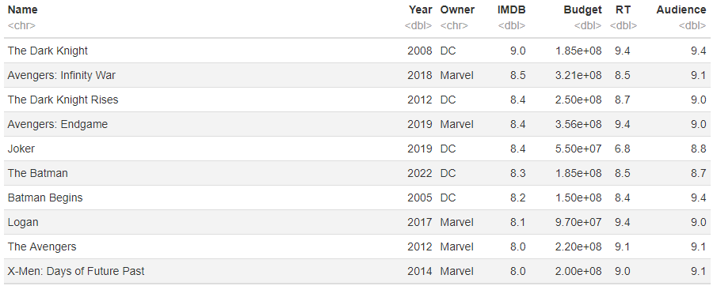
Best Movies (IMDB rating)

Slide 8
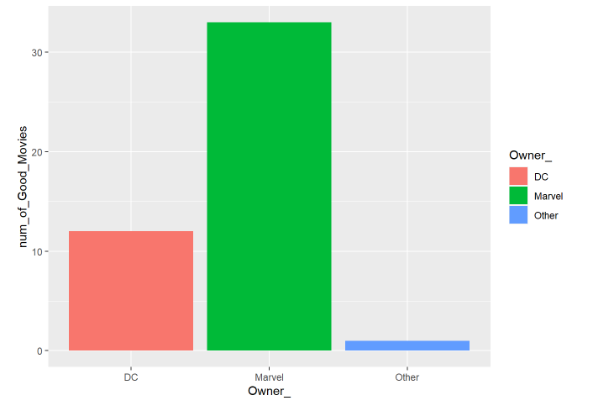
Best Movies (IMDB rating)
33 of the best movies are owned by Marvel
12 of the best movies are owned by DC
1 of the best movies are owned by Neither

Slide 9
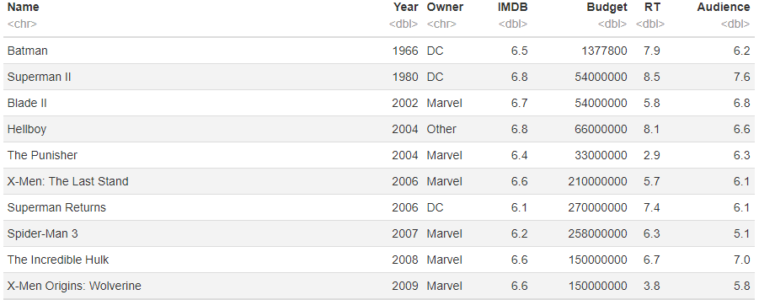
Average Movies (IMDB)

Slide 10
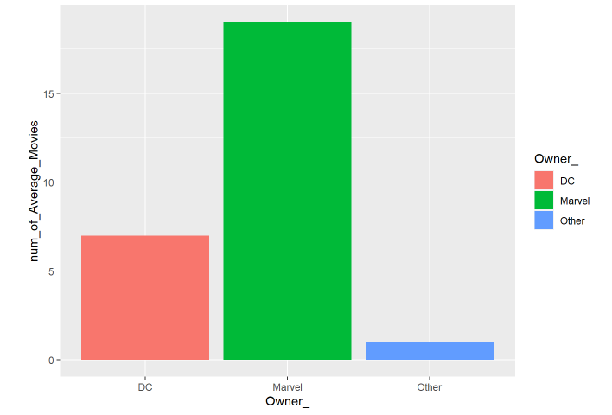
Average Movies (IMDB)
19 of the best movies are owned by Marvel
7 of the best movies are owned by DC
1 of the best movies are owned by Neither

Slide 11
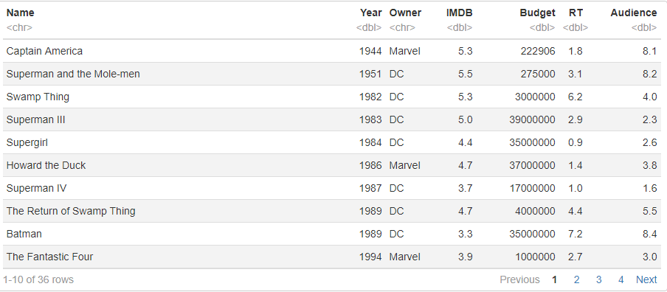
Bad Movies (IMDB Rating)

Slide 12
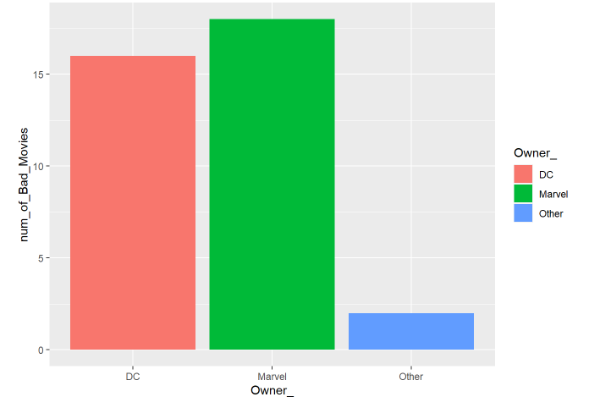
Bad Movies (IMDB Rating)
18 of the best movies are owned by Marvel
16 of the best movies are owned by DC
2 of the best movies are owned by Neither

Slide 13
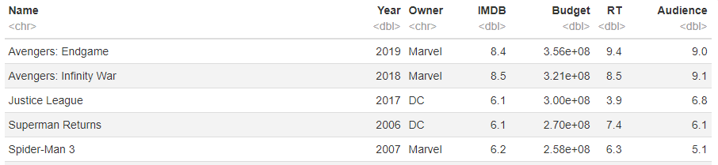
Top 5 most expensive Movies

Slide 14

most expensive Movie
Owned by Marvel
Budget 356 million USD
IMDB gave it an 8.4
Rotten Tomatoes a 9.4
Audience a 9.0

Slide 15
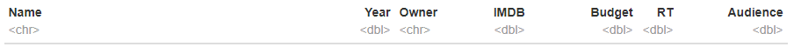
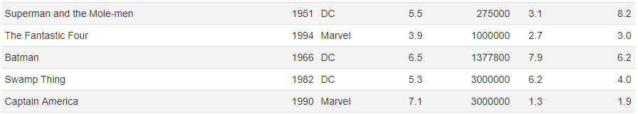
Top 5 cheapest Movies

Slide 16

cheapest Movie
Owned by DC
Budget 275 thousand USD
IMDB gave it a 5.5
Rotten Tomatoes a 3.1
Audience an 8.2

Slide 17
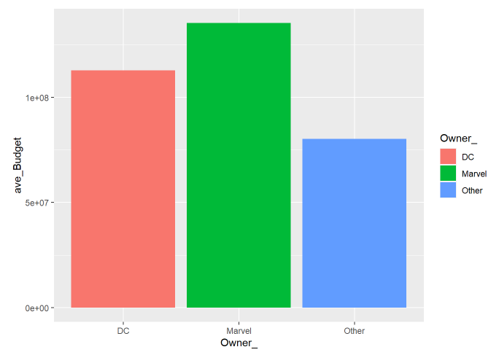

Budget Analysis

Slide 18
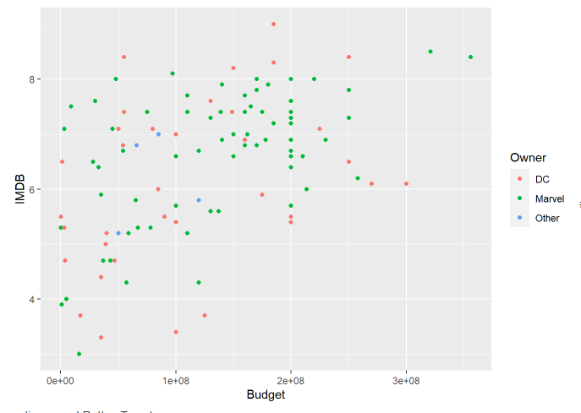
Budget impact on rating

Slide 19
Difference in rating systems

